Slide 1
Java Lab Assignment #3 Write a Java program to print a table based on power function values – Nicholas Carroll – 19 November 2018

Slide 2
Test Cases
Test Case 1:
“Enter a: “
“Enter b: “
Input: 2, 5
Output: “The value of a times the power of b is” 32
Test Case 2:
“Enter a: “
“Enter b: “
Input: -9, 2
Output: “The value of a times the power of b is” 81

Slide 3
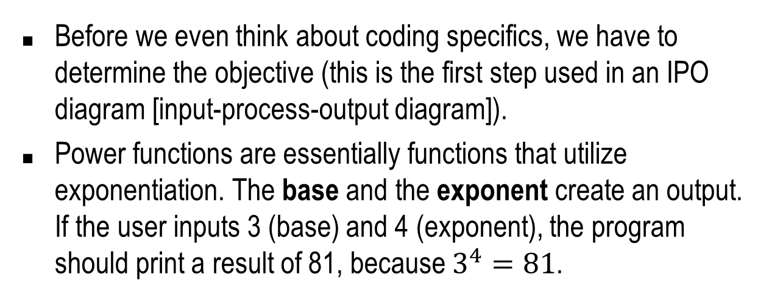
Analysis – what is known and given?
Before we even think about coding specifics, we have to determine the objective (this is the first step used in an IPO diagram [input-process-output diagram]).
Power functions are essentially functions that utilize exponentiation. The base and the exponent create an output. If the user inputs 3 (base) and 4 (exponent), the program should print a result of 81, because $3^{4}=81$.

Slide 4
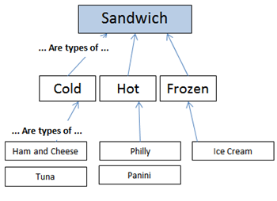
Example
The image demonstrates a polymorphism (one class, multiple methods) to OOP.

Slide 5
Analysis cont.
The compiler can calculate a value based on a base and exponent using the pow(a,b) method. Therefore, we have to import the Math and Scanner classes.
The program must run under a for loop, which means that it will repeat under certain condition or parameters. Before we declare the for loop, we must declare a loop control variable. Inside the parameters for the for loop, we have to make sure that program will explicitly run 4 times and it will increment by 1.

Slide 6
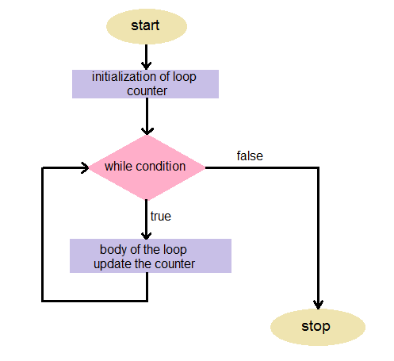
Example
Visualization of the for loop.

Slide 7
Algorithm
Create the package, import the Scanner and Math class respectively and create the main class.
Declare and initialize the necessary Scanner object to allow user input.
Declare three variables: a, b and loopcount.
Declare and give arguments to returnPowFuncValue(a, b, loopcount, input)
End the main program.

Slide 8
Algorithm cont.
Begin a new method named returnPowFuncValue(int a, int b, int loopcount, Scanner input)
Declare a for loop with a new variable called i and give it the parameters of equal to 0, less than or equal to 4 and incrementing by 1.
Print “Enter the base for this operation.” and store the user input into a.

Slide 9
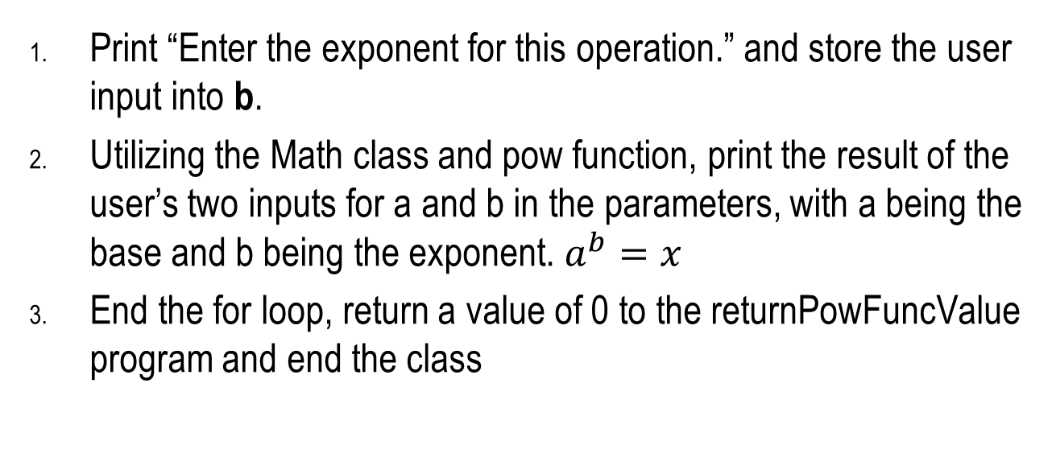
Algorithm cont.
Print “Enter the exponent for this operation.” and store the user input into b.
Utilizing the Math class and pow function, print the result of the user’s two inputs for a and b in the parameters, with a being the base and b being the exponent. $a^{b}=x$
End the for loop, return a value of 0 to the returnPowFuncValue program and end the class

